Slide 1
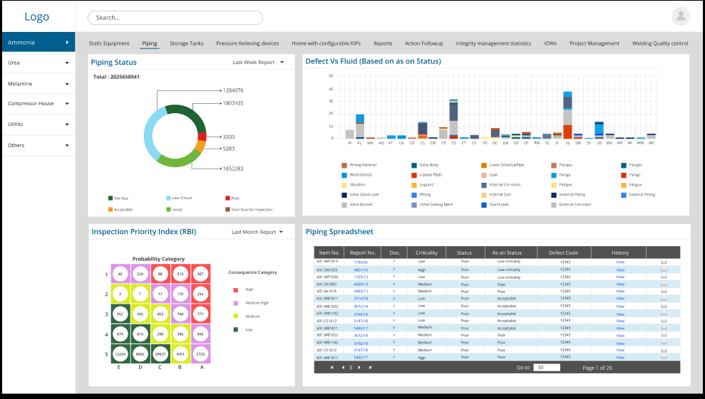
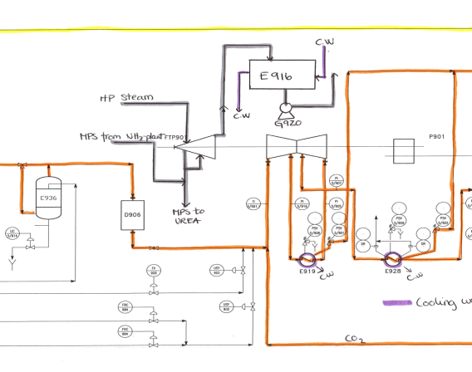
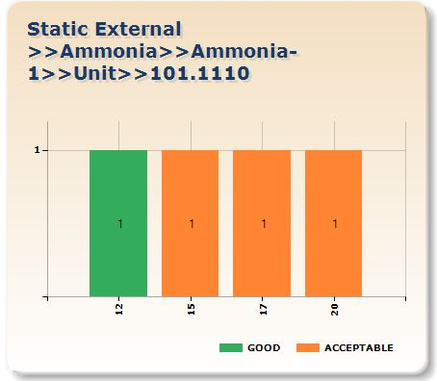
5th Tab – Environment Cracking
DM Code | Initial Sucep | Severity Index | Found | VH | H | M | L | Last Insp Year VH | Reduction Fac | Damage Factor | POF | DM name
Reports Menu
Piping
POF
COF
TML
ML no | Nom Thk | Dia | Min req t | Last Mea | Long T CR | Short Te | Half Li | Next I
01 | 5.6 | 6 | 3 | 4.5 | 0.15 | 0.1 | 5 | 2025
02 | 6 | 8 | 4 | 5 | 0.1 | 0.1 | 5 | 2025
03 | 7.2 | 10 | 5 | 6.5 | 0.25 | 0.2 | 10 | 2030
When a line number Environmental cracking tab is selected the charts will change to as shown above.
Top : will show a form with all relevant data required for SCC POF calculations of all relevant SCC DMs.
Right Bottom: shows the bar charts showing previous inspection confidence levels for this DM – for the DM row that is selected in above table
Left Bottom: Will show the drawings (may be more than one) indicating the CML locations on the drawing

Slide 2
Left Table
SCC Damage Mechanism
DM Code | Initial Sucep | Severity Index | Found | VH | H | M | L | Last Insp Year VH | Reduction Fac | Damage Factor | POF | DM name
In this table all relevant data is shown, all this data is populated from different tables like Piping Cluster table, POF-SCC table, Inspection confidence table.
Editing is possible by Integrity engineer.

Slide 3
Right top- TML locations
Drawing
In this window user should be able to attach marked document in pdf format.

Slide 4
Left Bottom- CML Trends
Confidence Level- Trend
In this window a graph showing the trend of Inspection confidence level from Inspection Confidence history table for this line.

